Slide 1
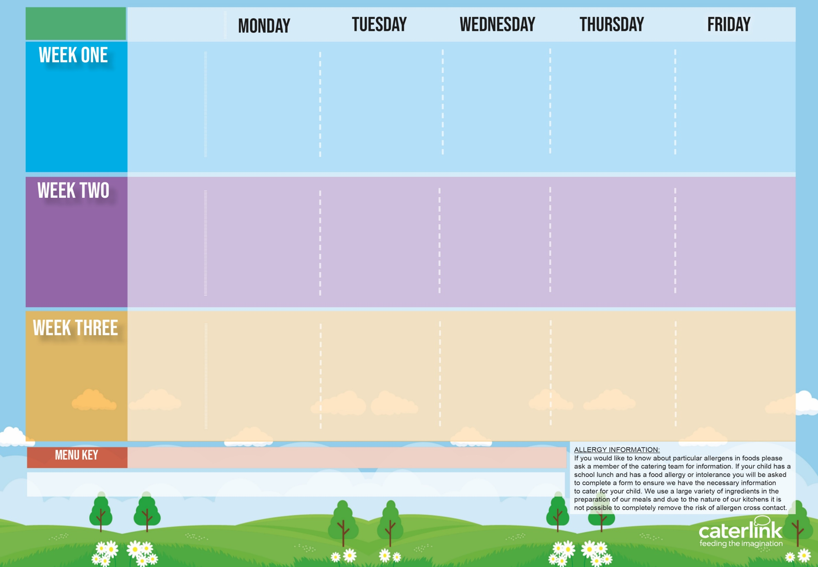
Kent & TKAT Spring Summer
2024
Option One
Option Two
Vegetables
Dessert
Cheese & Tomato Pizza with New Potatoes | Penne Bolognaise | Sausages, Roast Potatoes & Gravy | Greek Chicken Pitta with Rice, & Tzatziki or Cheese & Spinach Whirl with Rice, & Tzatziki | Fishfingers with Chips & Tomato Sauce
NEW Vegetable Tortilla Stack with Rice | Vegan Penne Bolognaise | Vegan Cumberland Sausage, Roast Potatoes & Gravy | or Cheese Whirl with *Rice and Salads | BBQ Quorn with Chips
Peas and Coleslaw | Carrots & Sweetcorn | Green Beans & Carrots | Vegetable Medley | Peas & Baked Beans
Apple Crumble with Ice Cream (cream for serverys) | Vanilla Shortbread with Mandarins | NEW Berry Mousse | Iced Vanilla Sponge | Fresh Fruit Platter
15/04/2024
06/05/2024
03/06/2024
24/06/2024
15/07/2024
09/09/2024
30/09/2024
21/10/2024
Option One
Option Two
Vegetables
Dessert
Pasta Kitchen Tomato Pasta or Creamy Cheese Pasta with Toppings | Burger in a Bun with Potato Wedges & Tomato Sauce | Roast Chicken, Stuffing, Roast Potatoes, & Gravy | Beef Lasagne with Garlic Bread | Fishfingers or Salmon Fishfingers with Chips & Tomato Sauce
 | Vegan Burger in a Bun with Potato Wedges & Tomato Sauce | Vegetable Wellington, Stuffing, Roast Potatoes & Gravy | Vegetable Curry with Rice | Mexican Bean Sausage Roll with Chips & Tomato Sauce
Vegetable Medley | Baked Beans & Peas | Carrots & Cabbage | Green Beans & Coleslaw | Peas & Baked Beans
NEW Chocolate Brownie | NEW Iced Biscuit With Peaches | Jelly with Mandarins | Oaty Cookie | Fresh Fruit Platter
22/04/2024
13/05/2024
10/06/2024
01/07/2024
22/07/2024
16/09/2024
07/10/2024
Option One
Option Two
Vegetables
Dessert
Macaroni Cheese | Chicken Paella with Patatas Bravas or Vegetable Wrap with Patatas Bravas | Roast Gammon, New Potatoes & Gravy | NEW Chicken Wrap with Rice | Fishfingers with Chips & Tomato Sauce
Vegan Chilli with Rice | or Veggie Meatballs with Patatas Bravas | Parsnip & Sweet Potato Loaf with New Potatoes & Gravy | Vegetable Lasagne & Garlic Bread | Cheese & Bean Pasty with Chips
Peas & Carrots | Vegetable Medley | Carrots & Broccoli | Sweetcorn & Peppers | Peas & Baked Beans
Chocolate Shortbread | Summer Lemon Cake | Peaches & Ice Cream (cream for servery) | Syrup Snap Biscuit With Mandarins | Fresh Fruit Platter
29/04/2024
20/05/2024
17/06/2024
08/07/2024
02/09/2024
23/09/2024
14/10/2024
Added Plant Power
Wholemeal
Vegan
Available Daily: - Freshly cooked jacket potatoes with a choice of filling - Cheese, Beans or Tuna, Bread freshly baked on site - Daily Salad Bar, Fruit Selection & Yoghurt

Slide 2
Kent & TKAT Spring Summer
2024
Option One
Option Two
Vegetables
Dessert
V231 Cheese & Tomato Pizza with SD2 New Potatoes | B48 SD125 Penne Bolognaise | P3/ C6 Sausages, SD82 Roast Potatoes & SD118 Gravy | Yamas GR1 Greek Chicken Pitta with GR5 Rice, GR3 Tzatziki & GR4 Salad or GR2 Cheese & Spinach Whirl with GR5 Rice, GR3 Tzatziki & GR4 Salad | F6 Fishfingers with SD5 Chips & SD14 Tomato Sauce
V250 Vegetable Stack with SD84 Rice | V233 SD125 Vegan Penne Bolognaise | V167 Vegan Cumberland Sausages, SD82 Roast Potatoes & SD118 Gravy | or Cheese Whirl with *Rice and Salads | V205 BBQ Quorn with SD5 Chips
D18 Peas & D47 Coleslaw | D28 Carrots & D19 Sweetcorn | D24 Green Beans & D28 Carrots | V102 Vegetable Medley | D18 Peas & D22 Baked Beans
D242 Apple Crumble & D13 Ice Cream D229 Cream | D57 Vanilla Shortbread & D167 Mandarins | D248 Berry Mousse | D177 Iced Vanilla Sponge | D225 Fresh Fruit Platter
15/04/2024
06/05/2024
03/06/2024
24/06/2024
15/07/2024
09/09/2024
30/09/2024
21/10/2024
Option One
Option Two
Vegetables
Dessert
Pasta Kitchen V188 Tomato Pasta or PK2 Carbonara Pasta with PK3 PK4 V85 V216 Toppings Pasta Codes: SD8 SD9 SD11 SD121 SD125 | B5 / BB1 SD17 Burger with SD6 Potato Wedges & SD14 Tomato Sauce | C4/C5 Roast Chicken, SD40 Stuffing, SD82 Roast Potatoes, & SD118 Gravy | B52 Beef Lasagne With SD50 Garlic Bread | F6 Fishfingers or F1 Salmon Fishfingers with SD5 Chips & SD14 Tomato Sauce
 | BB3 SD17 Beet Burger with SD6 Potato Wedges & SD14 Tomato Sauce | V232 Vegetable Wellington SD40 Stuffing, SD82 Roast Potatoes, & SD118 Gravy | V108 Vegetable Curry With SD84 Rice | V161 Mexican Bean Sausage Roll with SD5 Chips & SD14 Tomato Sauce
D103 Vegetable Medley | D22 Baked Beans & D18 Peas | D28 Carrots & D35 Cabbage | D24 Green Beans & D47 Coleslaw | VD18 Peas & D22 Baked Beans
D169 Chocolate Brownie | D250 Iced Biscuit With D166 Peaches | D235 Jelly With Mandarins | D85 Oaty Cookie | D225 Fresh Fruit Platter
22/04/2024
13/05/2024
10/06/2024
01/07/2024
22/07/2024
16/09/2024
07/10/2024
Option One
Option Two
Vegetables
Dessert
V11 Macaroni Cheese | Fiesta Espanol FE1 Chicken Paella with FE4 Patatas Bravas or V252Vegetable Fajita with FE4 Patatas Bravas | P5 Roast Gammon, SD2 New Potatoes & SD118 Gravy | C92 Chicken Fajitas with SD84 Rice | F6 Fishfingers with SD5 Chips & SD14 Tomato Sauce
V239 Vegan Chilli with SD84 Rice | or Veggie Meatballs with Patatas Bravas | TD56 Parsnip & Sweet Potato Loaf , SD2 New Potatoes SD118 Gravy | V242 Vegetable Lasagne & SD50 Garlic Flavoured Bread | V191 Cheese & Bean Pasty with SD5 Chips
VD18 Peas & D28 Carrots | D103 Vegetable Medley | D28 Carrots & SD20 Broccoli | SD19 Sweetcorn & SD26 Peppers | D18 Peas & D22 Baked Beans
D80 Chocolate Shortbread | D168 Summer Lemon Cake | D166 Peaches & D13 Ice Cream or D229 Cream | D219 Sugar Snap Biscuit & D167 Mandarins | D225 Fresh Fruit Platter
29/04/2024
20/05/2024
17/06/2024
08/07/2024
02/09/2024
23/09/2024
14/10/2024
Added Plant Power
Wholemeal
Vegan
Available Daily: - Freshly cooked jacket potatoes with a choice of filling - Cheese, Beans or Tuna, Bread freshly baked on site - Daily Salad Bar, Fruit selection & Yoghurt
The Recipe will have PRI in front of the recipe code meaning (PRIMARY) , but not on the coded ,menu

